Slide 1
MecaFIX

Slide 2
Outline
Title
Problem/Background
Solution
Business model
Value proposition
Marketing and sales
Competition
Team
Financial projections
Current status/timeline

Slide 3
Title
|MecaFIX
By TELEIN

Slide 4

Problem
Problem/issues in getting to a mechanic promptly to attend to a motorist.
Most times motorists in a bid to get their vehicle moving use the services of just any mechanic thereby worsening the case of their vehicle.
Challenges of maintaining the vehicle.
Motorists are at risk and danger while being stranded.

Slide 5
Solution
|MecaFIX
Based on the highlighted problems encountered we have been able to create this solutions. These solutions are then combined together to create the “MecaFIX ”
Empowering car owners (motorists) to find suitable mechanics and auto-part dealers on the nearest location.
Allowing mechanics the opportunities to connect motorists.

Slide 6
Business Model

Slide 7

Value Proposition
Bringing reliable services right to you.
Committing motorist to trustworthy mechanics.
Connecting motorist to authentic spare parts dealers.
Discounts upon referrals.
Discounts after using the website 3 times.

Slide 8
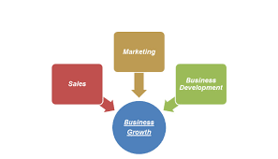
Marketing and Sales
Use of social media
Use of promotion to attract customers
Flyers distribution
Adverts
Generating traffic --- we make ads on the website

Slide 9

Competition
Mechanic.ng
Mymoto.com
Carpartsnigeria.com
Callyourmechanic.com

Slide 10

Team
Idris
Nmesoma
Loyal
Ebruba
Temiloluwa
Ezekiel

Slide 11
Financial Projections

Slide 12
Current Status/Timeline
At the moment MecaFIX is a start-up. Our status projection for the next three years is to be among the leading cutting-edge technologies.

